Slide 1
Determining Global States of Distributed Systems
Presented by
Sanjeev R. Kulkarni

Slide 2
References
1. “Distributed Snapshots: Determining Global States of Distributed Systems”, K. Mani Chandy and Leslie Lamport, ACM Transactions on Computer Systems, vol 3, no 1, Feb85.
2. “PUBLISHING: A Reliable Broadcast Communication Mechanism”, Michael L. Powell and David L. Presotto, Proceedings of the Ninth ACM Symposium on Operating Systems Principles, Oct 83.
3. Consistent Global States of Distributed Systems: Fundamental Concepts and Mechanisms, Ozalp Babaoglu and Keith Marzullo, Distributed Systems, Sape J. Mullender, Addison-Wesley, 1993.

Slide 3
Outline of the talk
Complexities of state detection in Distributed Systems
The notion of Consistent States
The Distributed Snapshots algorithm
Application to detect Stable Properties and Checkpointing
Another approach for state recording: Publishing

Slide 4
Model of Computation
Finite set of processes
Process send messages on a finite set of unidirectional channels
Channels are error free, FIFO and have infinite buffers
Messages experience arbitrary but finite delays
Strongly connected network

Slide 5
Model of Computation (cont.)
A computation is a sequence of events.
An event is an atomic action that changes the state of a process and at most one channel state that is incident on that channel.
S_{p}⁰
S_{p}¹
S_{p}²
S_{p}³
p
q
S_{q}⁰
S_{q}¹
S_{q}²
`
S_{q}³

Slide 6
Happened Before Relation
Events e and e` of the same process.
  if e happens before e` then e e`
e and e` in two different processes
  if e = send(m) and e` = recv(m) then e e`
Transitive
  if e e` and e` e`` then e e``

Slide 7
Determining Global States
Global State
“The global state of a distributed computation is the set of local states of all individual processes involved in the computation plus the state of the communication channels.”

Slide 8
More on States
process state
  memory state + register state + signal masks + open files + kernel buffers + …
        Or
  application specific info like transactions completed, functions executed etc,.
channel state
  “Messages in transit” i.e. those messages that have been sent but not yet received

Slide 9
What’s the need for global states?
Many problems in Distributed Computing can be cast as executing some action on reaching a particular state
e.g.
  distributed deadlock detection is finding a cycle in the Wait For Graph.
  Termination detection
  Checkpointing
  many more…..

Slide 10
Why global state determination is difficult in Distributed Systems?
Distributed State :
Have to collect information that is spread across several machines!!
Only Local knowledge :
A process in the computation does not know the state of other processes.

Slide 11
Difficulties
Instantaneous recording not possible
  No global clock : Distributed recording of local states cannot be synchronized based on time
  Random Network Delays : No centralized process can initiate the detection

Slide 12
Difficulties due to Non Determinism
Deterministic Computation
  At any point in computation there is at most one event that can happen next.
Non-Deterministic Computation
  At any point in computation there can be more than one event that can happen next.

Slide 13
Deterministic Computation Example
A Variant of producer-consumer example
Producer code:
while (1)
{
produce m;
send m;
wait for ack;
}
Consumer code:
while (1)
{
recv m;
consume m;
send ack;
}

Slide 14
Example: Initial State
m

Slide 15
Example
m

Slide 16
Example
m

Slide 17
Example
a

Slide 18
Example
a

Slide 19
Example
a

Slide 20
Deterministic state diagram

Slide 21
Non-deterministic computation
3 processes
p
m₁
q
m₂
r
m₃

Slide 22
Three possible runs
p
p
m₁
m₁
m₃
q
q
m₃
m₂
m₂
r
r
p
m₁
m₃
q
m₂
r

Slide 23
A Non-Deterministic Computation
All these states are feasible

Slide 24
Feasible and Actual States
Any state that an external observer could have observed is a feasible state
A state that an external observer did observe is an Actual state

Slide 25
A Non-Deterministic Computation
Only some states are actual

Slide 26
Non-Determinism
Deterministic computation
  A local event would reveal everything about the global state!
  The process will know other process’ state
Not so for Non-Deterministic computation!
m

Slide 27
A naïve snapshot algorithm
Processes record their state at any arbitrary point
A designated process collects these states
+ So simple!!
- Correct??

Slide 28
Example
Producer Consumer problem
p records its state
p
q
m

Slide 29
Example
p
q
m

Slide 30
Example
q records its state
p
q
m

Slide 31
Example
The recorded state
p
q
m
m

Slide 32
Where did we err?
What did we do?
p
m
q

Slide 33
Error!!
The sender has no record of the sending
The receiver has the record of the receipt
Result
  Global state has record of the receive event but no send event violating the happened before concept!!

Slide 34
The notion of Consistency
A global state is consistent if it could have been observed by an external observer
If e e` then it is never the case that e` is observed by the external observer and not e
All feasible states are consistent

Slide 35
An Example
p
q
S_{p}⁰
S_{p}¹
S_{p}²
S_{p}³
p
m₂
m₁
m₃
q
S_{q}⁰
S_{q}¹
S_{q}²
S_{q}³

Slide 36
A Consistent State?
p
q
S_{p}¹
S_{q}¹
S_{p}⁰
S_{p}¹
S_{p}²
S_{p}³
p
m₂
m₁
m₃
q
S_{q}⁰
S_{q}¹
S_{q}²
S_{q}³

Slide 37
Yes
p
q
S_{p}¹
S_{q}¹
S_{p}⁰
S_{p}¹
S_{p}²
S_{p}³
p
m₂
m₁
m₃
q
S_{q}⁰
S_{q}¹
S_{q}²
S_{q}³

Slide 38
A Consistent State?
p
q
S_{p}²
S_{q}³
m₃
S_{p}⁰
S_{p}¹
S_{p}²
S_{p}³
p
m₂
m₁
m₃
q
S_{q}⁰
S_{q}¹
S_{q}²
S_{q}³

Slide 39
Yes
p
q
S_{p}²
S_{q}³
m₃
S_{p}⁰
S_{p}¹
S_{p}²
S_{p}³
p
m₂
m₃
m₁
q
S_{q}⁰
S_{q}¹
S_{q}²
S_{q}³

Slide 40
An inconsistent State
p
q
S_{p}¹
S_{q}³
S_{p}⁰
S_{p}¹
S_{p}²
S_{p}³
p
m₂
m₁
m₃
q
S_{q}⁰
S_{q}¹
S_{q}²
S_{q}³

Slide 41
Chandy and Lamport Algorithm
Features:
  Does not promise us to give us exactly what is there
  But gives us consistent state!!

Slide 42
A brief sketch of the algorithm
(from process p’s perspective)
p sends a marker message along all its outgoing channels after it records its state and before it sends any other messages.
On receipt of a marker message from channel c
  else
    state ( c ) = messages received on c since it had recorded its state excluding the marker.
  if p has not recorded its state
    record the state
    state ( c ) = EMPTY

Slide 43
Algorithm in Action
p
S_{p}⁰
S_{p}¹
S_{p}²
S_{p}³
m₁
m₂
m₃
q
S_{q}⁰
S_{q}¹
S_{q}²
S_{q}³

Slide 44
Algorithm in Action
q records state as S_{q}¹ , sends marker to p
p
S_{p}⁰
S_{p}¹
S_{p}²
S_{p}³
m₁
m₂
m₃
q
S_{q}⁰
S_{q}¹
S_{q}²
S_{q}³

Slide 45
Algorithm in Action
p records state as S_{p}², channel state as empty
p
S_{p}⁰
S_{p}¹
S_{p}²
S_{p}³
m₁
m₂
m₃
q
S_{q}⁰
S_{q}¹
S_{q}²
S_{q}³

Slide 46
Algorithm in Action
q records channel state as m₃
p
S_{p}⁰
S_{p}¹
S_{p}²
S_{p}³
m₁
m₂
m₃
q
S_{q}⁰
S_{q}¹
S_{q}²
S_{q}³

Slide 47
Algorithm in Action
Recorded Global State = ((S_{p}², S_{q}¹), (0,m₃) )
p
S_{p}⁰
S_{p}¹
S_{p}²
S_{p}³
m₁
m₂
m₃
q
S_{q}⁰
S_{q}¹
S_{q}²
S_{q}³

Slide 48
Why this is consistent
Proof that if recv(m) is recorded then send(m) is also recorded.
M
m
p
q

Slide 49
Algorithm in Action
Recorded Global State = ((S_{p}², S_{q}¹), (0,m₃) )
Moral: Computation may not even have
passed through the state recorded!
p
S_{p}⁰
S_{p}¹
S_{p}²
S_{p}³
m₁
m₂
m₃
q
S_{q}⁰
S_{q}¹
S_{q}²
S_{q}³

Slide 50
What have we recorded
The recorded consistent state can be anything!

Slide 51
Properties of the recorded global state
If S_{i} and S_{j} are the global state when Lamport’s algorithm started and finished respectively and S* is the state recorded by the algorithm then,
  S* is reachable from S_{i}
  S_{j} is reachable from S*

Slide 52
S* Is reachable from S_{i}
S_{i}
S_{j}

Slide 53
S_{j} Is reachable from S*
S_{i}
S_{j}

Slide 54


Still what good is it?
Stable Properties
  A property is called a stable property iff for all states S` reachable from S
  Eg: Deadlock, Termination, Token loss

Slide 55
Stable Properties
S_{i}
S*
S_{j}

Slide 56
Stable Properties
S_{i}
S*
S_{j}

Slide 57
Detection of Stable Properties
Outcome = false;
while ( outcome == false )
{
determine Global State S;
outcome = (S);
}

Slide 58
Checkpointing
S* serves as a checkpoint
On a failure, restart the computation from S*
Problem!
  Not able to restore to Sj
S_{i}
S*
S_{j}

Slide 59
Solution: Publishing
A Broadcast medium
A central recorder process records all the messages received by each process
Processes record their states at their own time and send it to the recorder

Slide 60
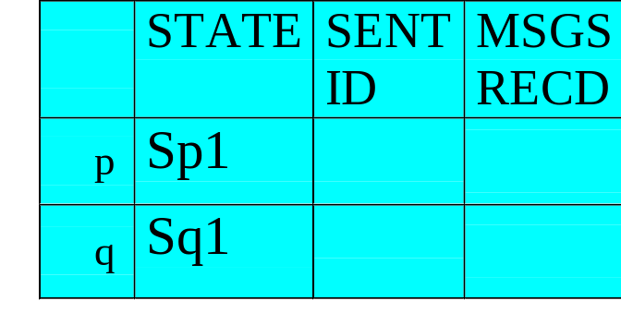
Architecture of Publishing
recorder
Sp1
Sq1
p
q

Slide 61
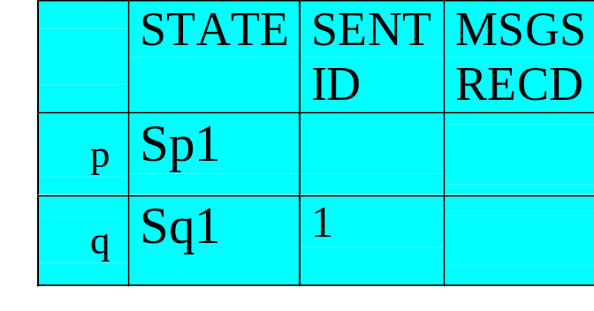
q sends the message
m₁
recorder
Sp1
Sq2
p
q

Slide 62
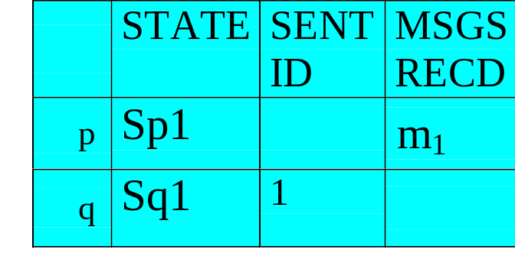
p sends an ack recorder records m₁
recorder
Sp2
Sq2
p
q

Slide 63
Determining Global State
Recorder can construct global state from
  Checkpointed States of all processes
  Plus
  Messages recd since last checkpoint

Slide 64
Problems
Publishing keeps track of all messages received by each process
Expensive!
Solution
  recorder takes checkpoint of process p at time t
  deletes all messages recd by p before t.

Slide 65
p checkpoints
recorder
Sp2
Sq2
p
q

Slide 66

Recorder stores Sp2 deletes m₁
recorder
Sp2
Sq2
p
q

Slide 67
The initial situation
recorder
Sp2
Sq2
p
q

Slide 68
Say p crashes
recorder
Sq2
p
q

Slide 69
Recorder reinstates p to Sp1
recorder
Sq2
Sp1
p
q

Slide 70
Replays back m₁
m₁
recorder
Sq2
Sp2
p
q

Slide 71
q crashes
recorder
Sp2
p
q

Slide 72
Recorder reinstates q to Sq1
recorder
Sp2
Sq1
p
q

Slide 73
Ignore m₁
m₁
recorder
Sp2
Sq1
p
q

Slide 74
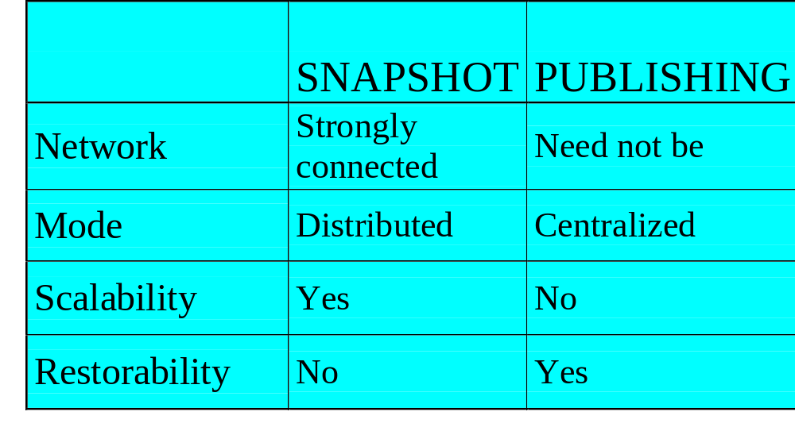
Comparison

Slide 75
Summary
Global State detection difficult in Distributed Systems
Snapshot algorithm may not give an actual state but is very helpful in detecting Stable Properties
Publishing gives an asynchronous way of determining global states but is unscalable

